Slide 1
WEEK 9

Slide 2
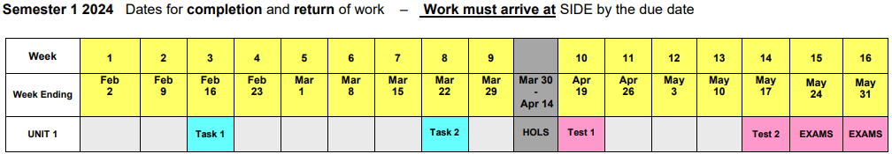
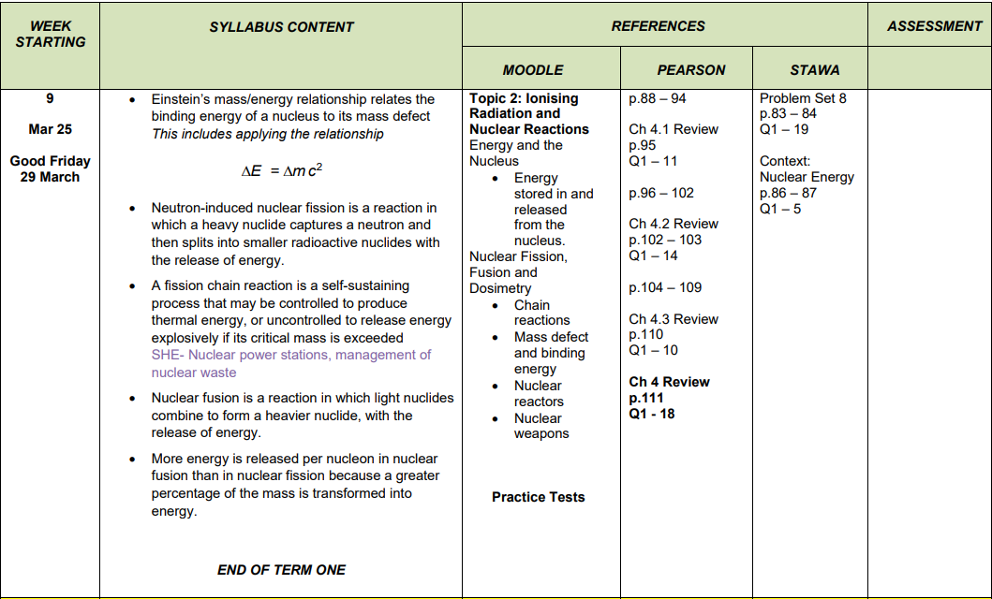

Slide 3
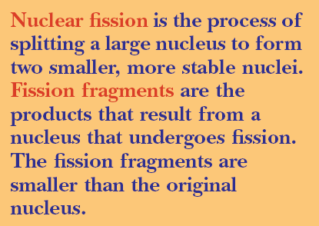
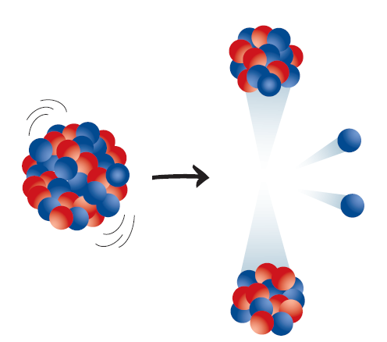
Nuclear Fission
Only one naturally occurring isotope will spontaneously undergo fission. That isotope is uranium-235.

Slide 4
Slow Neutrons
It is far more common for fission to be initiated when nuclei are bombarded with slow-moving neutrons.
When a slow-moving neutron collides with a nucleus it is temporarily absorbed, producing a very unstable isotope with very short half-life. This isotope then splits into two fission fragments, and releases energy.
Three isotopes are fissionable under these circumstances — naturally occurring uranium-235, artificially produced uranium-233, and plutonium -239.

Slide 5

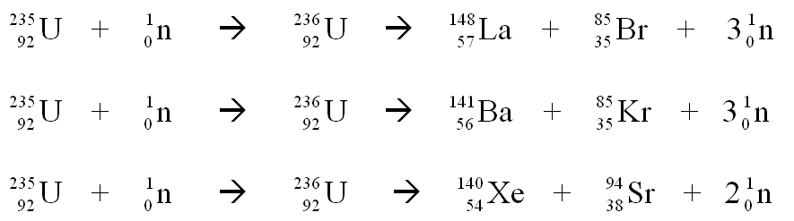
Nuclear Fission – Variable Outcomes
The fission fragments are not always the same, even when the same initial nucleus is used, although some pairs occur more frequently than others.
One fragment often has a mass of approximately 140, while the other fragment has a mass of about 90. Some possible equations for the fission of uranium-235 set off by the absorption of a neutron are:

Slide 6
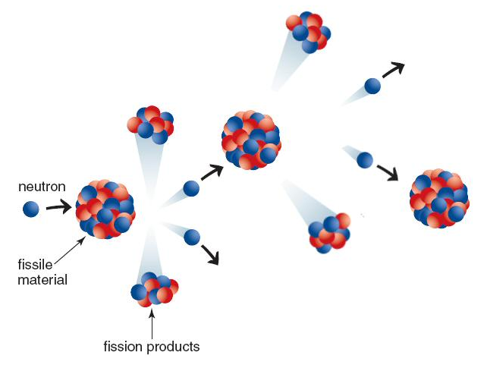
Chain Reactions
A chain reaction occurs when neutrons, emitted from the decay of one atom, are free to initiate fission in surrounding nuclei.

Slide 7
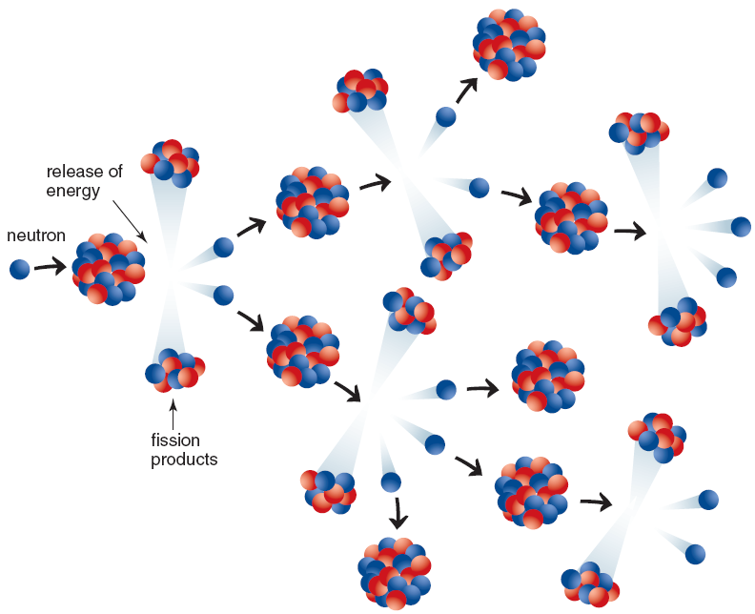
Uncontrolled Chain Reactions
An uncontrolled chain reaction occurs when every free neutron goes on to produce another fission reaction. It occurs in nuclear bombs and releases an enormous amount of energy.

Slide 8
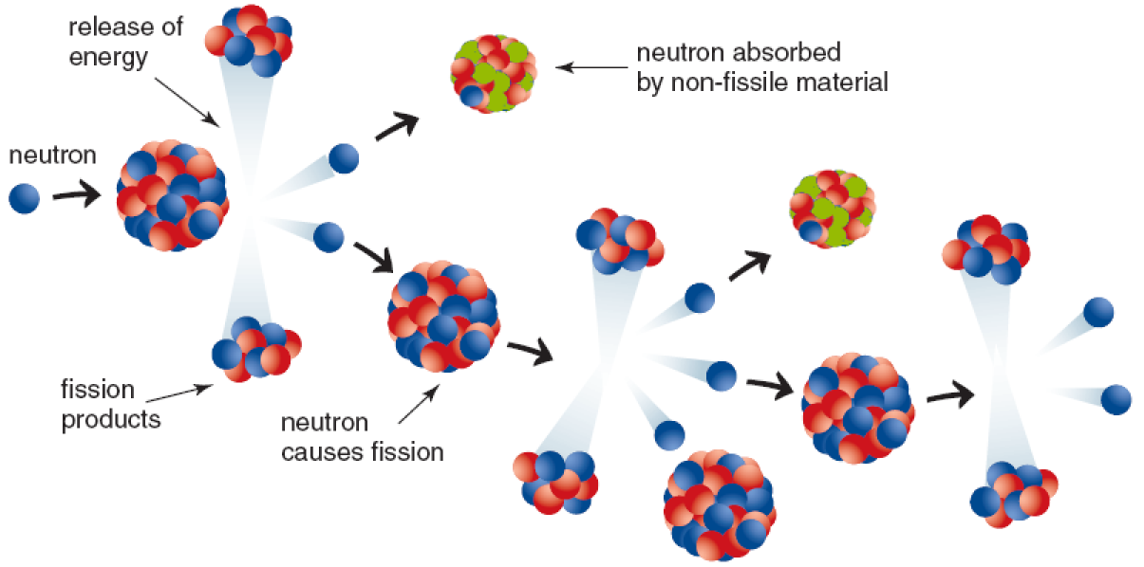
Controlled Chain Reactions
Some, or all, of the free neutrons could be absorbed by a material that is not fissionable. This would mean that the absorbed neutron would not cause another fission. Depending on the number of absorbed neutrons, the chain may continue at a slower rate or simply die out.

Slide 9
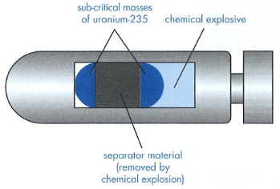

Critical Mass
Critical mass refers to the mass of fissile material required to sustain an uncontrolled chain reaction such as that which occurs in an atom bomb.

Slide 10
Critical Mass
When an atom bomb is detonated, two separate masses of fissile material, each less than critical mass, are forced together by a chemical explosive.
The two combined masses are then greater than critical mass and an explosion results.

Slide 11
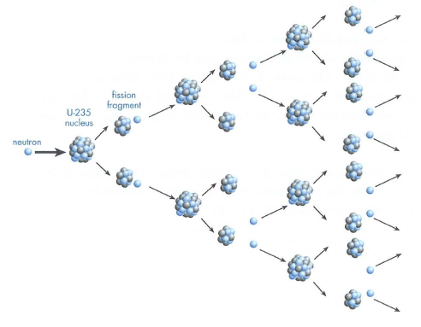
Critical mass
If too little matter is present most of the neutrons produced in a
fission reaction escape from the material without interaction.
Critical mass depends on the % of U-235 in a sample since U-238
is not fissile.
It also depends on the geometry (shape) of the mass.
For pure U-235 critical mass is only a few kilograms, while for 3%
enriched uranium it is several tonnes.

Slide 12
Nuclear Reactors
Nuclear reactors are able to produce large quantities of heat as a result of a controlled chain reaction.
Enriched uranium-235 is used in thermal reactors while plutonium-239 is used in fast-breeder reactors.
The heat produced in a reactor passes through a heat exchanger and eventually drives a turbine to produce electricity

Slide 13
Nuclear Reactors
Reactor design can vary widely, with the choice of fuel and moderator being of particular importance.
In order that a controlled chain reaction can be sustained in a reactor an average of 1 neutron from each fission must cause another fission.
Enriched uranium is the preferred fuel since natural uranium only contains 0.7% of fissile material.
Also, since slow neutrons are more likely to cause the fission of uranium-235, a moderator is used to slow down the energetic neutrons produced during fission reactions.

Slide 14
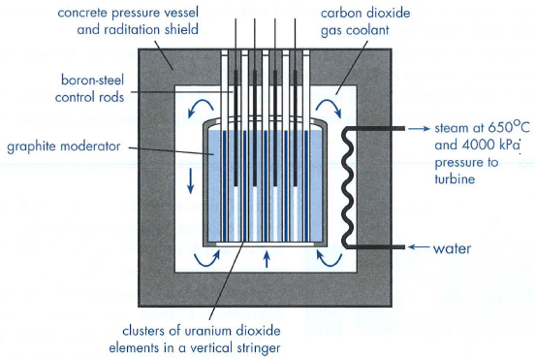
Nuclear Reactor Design
Nuclear fuel. Modern reactors use enriched uranium (2% to 3% uranium-235) in the form of uranium dioxide.
Control rods. The rate of the fission reaction is controlled by lowering or raising the boron-steel control rods. Neutrons are absorbed by the boron and inhibit the chain reaction.

Slide 15
Nuclear Reactor Design
Moderator. A material which is used to deliberately slow
down the neutrons to a speed that increases the chance of interaction with the U-235. Graphite, water, heavy water and beryllium are commonly used as moderator materials.
.
Notes:
Although fast neutrons can cause fission in uranium-238 (the more abundant isotope),
the probability of fission of uranium-235 by slow neutrons is much higher.

Slide 16
Nuclear Reactor Design
Coolant. This can be water, a gas, or liquid metal. The coolant removes heat from the reactor core and transfers it to the outside of the reactor for the generation of electricity.
Radiation shield. This consists of very thick reinforced concrete. Its purpose is to protect workers and the nearby environment.

Slide 17
Fast Breeder Reactors
These reactors use mixed plutonium and uranium fuel which is initially produced as a by product of thermal reactors.
Fast moving neutrons cause the fission of the plutonium-239 and hence the release of energy.
These reactors also convert the normally wasted uranium-238 to plutonium-239, hence the name breeder reactors.
Notes:
Plutonium however, is a highly hazardous material and also used in weapons manufacture. Hence
the construction of these type of reactors is somewhat controversial. They also present some major
design and cost problems.

Slide 18
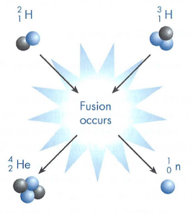
Nuclear Fusion
If two light nuclei can be brought close enough together they fuse and form a heavier nucleus. This fusion process, like fission, releases huge amounts of energy.
This release of energy is possible since atoms such as helium have a much greater binding energy per nucleon than smaller atoms such as hydrogen and deuterium. This indicates that the helium nucleus is particularly stable.

Slide 19
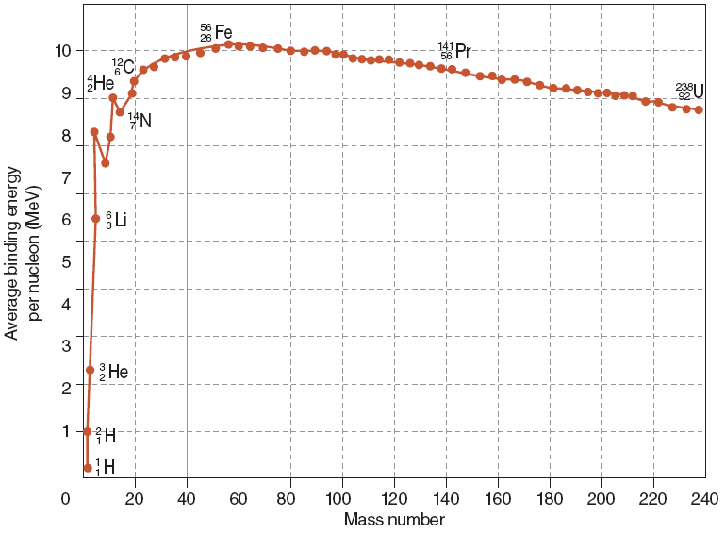

Slide 20
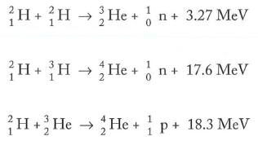
Typical Fusion Reactions
Notes:
Fusion reactions however are difficult to sustain. Strong electrostatic forces prevent nuclei from
coming close enough together for the strong nuclear forces to be effective. Temperatures in the
order of 100 million K (108 K) are necessary to maintain such reactions. Nuclear fusion occurs on
the sun and during the explosion of a hydrogen bomb.

Slide 21

Deuterium – Tritium Fusion
Several fusion reactions form the helium nucleus but that between deuterium and tritium occurs the most easily.
The major attractions of fusion power produced from such a process are
• A ready supply of fuel that is almost limitless.
• Waste products that are non-radioactive.
Safer reactors.
Notes:
• A ready supply of fuel that is almost limitless. Deuterium is available from sea water while
tritium can be produced from beryllium.
• Waste products that are non-radioactive. This is a huge advantage over present fission reactors
since it removes the problem of storing radioactive wastes safely for long periods.
Safer reactors. Fusion reactors dealing with low density plasma would not be subject to melt
down. Reactors could be sited more readily within communities.

Slide 22
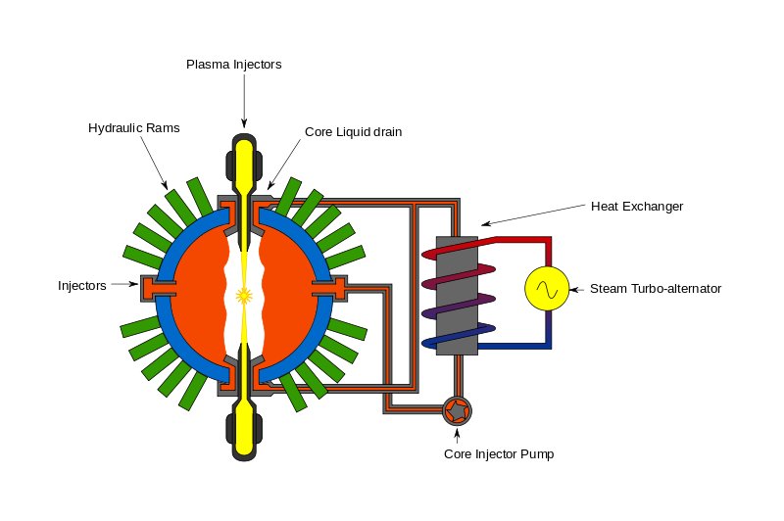
Fusion Reactors
The major difficulty in harnessing fusion power is the very high temperature needed for the reaction. At these high temperatures plasma (very hot ionised gas) cannot be easily confined.
Source: https://commons.wikimedia.org/wiki/File:General_Fusion_Reactor.svg
Notes:
Research is being undertaken using strong magnetic fields to trap the plasma that exists during a fusion
reaction. At present the most encouraging design is a doughnut shaped device known as a tokomak.
It uses large currents to create a toroidal magnetic field which can hold the plasma away from the
container walls. Scientists are hopeful that this will lead to a practical fusion reactor in the future

Slide 23
Hydrogen Bomb
The temperature produced by a simple fission bomb (atom bomb) can be used to initiate a thermonuclear reaction.
A hydrogen bomb essentially consists of a small atomic bomb surrounded by large amounts of lithium and deuterium.
The initial fission reaction raises the temperature sufficiently for fusion to take place between deuterium and tritium.
The tritium is formed when neutrons interact with lithium. Vast amounts of energy are released.

Slide 24
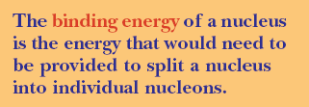
Binding Energy

Slide 25
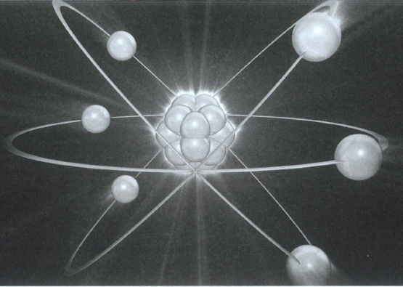
Nuclear Binding Energy
Protons and neutrons are held together in the nucleus by the strong nuclear force.
If we were to separate these particles from each other by totally breaking up the nucleus, a great deal of energy would be required.
This energy is referred to as the binding energy of the nucleus.
Conversely, when individual particles come together to form a nucleus, energy is released.
This release of energy is always accompanied by a loss of mass.

Slide 26
Binding Energy
This graph of binding energy versus mass number shows that iron has the most stable nucleus.

Slide 27
Mass Defect
This loss of mass can be calculated using Einstein's mass energy equation, and is called the mass defect.
This means that the measured mass of a nucleus is always less than the sum of the individual masses of its nucleons.
The example that follows illustrates this process.

Slide 28
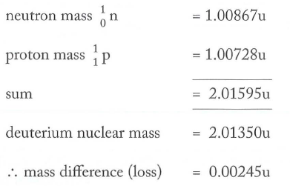
Mass Defect Calculation
When a neutron combines with a proton to form a deuterium nucleus the masses involved are as follows:
This loss of mass on formation of the deuterium nucleus is accompanied by a release of approximately 2.3 MeV of energy. This is the binding energy of the nucleus and is the energy that would be required to pull the nucleus apart.

Slide 29
The Electron Volt (eV)
The energy equivalent of a nucleon mass is very small so a new unit is used
1 electron-volt (eV) = equivalent to the energy that 1 electron gains when it moves through a potential difference of 1 volt.
1 eV = 1.602 x 10⁻¹⁹ J
The energy equivalent of 1 unified mass unit (u) = 931.5 MeV

Slide 30
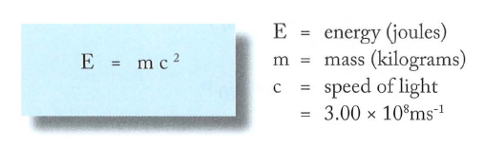
Einstein’s Mass-Energy Equation.
Albert Einstein's special theory of relativity shows that mass is a form of energy. The relationship between these two quantities is given by his famous equation

Slide 31
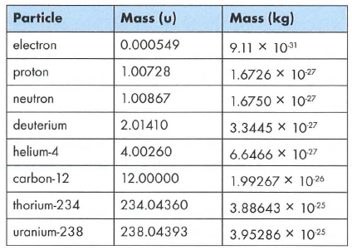
Atomic mass.

Slide 32
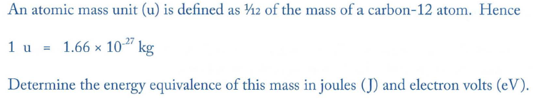
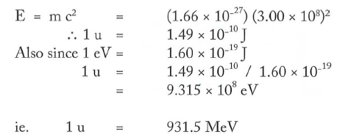
Example 2.5

Slide 33
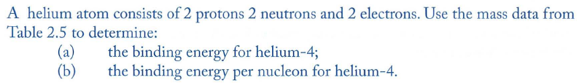
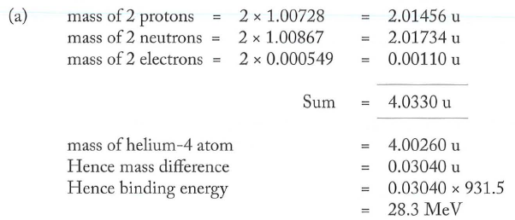

Example 2.6

Slide 34
Your turn!
Find the energy equivalent of a free proton in:
A) Joule (J)
B) Electron volt (eV)

Slide 35

Your turn!
The total mass of one atom of ${}_{1}^{3}H\left(Tritium\right)$ is 3.016049 u. Calculate to 3 significant figures the nuclear binding energy per nucleon for this atom.

Slide 36
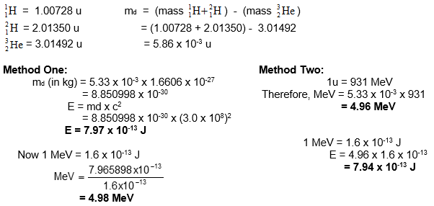
Nuclear Reaction Calculations
Similar to calculating binding energy within a nucleus except we get the mass defect from the difference in mass between the reactants (more mass) and the products (less mass)

Slide 37
Biological Effects of Radiation
When ionising radiation interacts with living cells it transfers its energy to the individual atoms that make up the cell.
This may cause damage to the cell by ionisation and the formation of extremely chemically reactive atoms or groups of atoms known as free radicals.
Where atoms or molecules are ionised, this can cause a change in the cell processes and cell chemistry.
If DNA molecules are ionised for example, the effect may be the prevention of cell division, the premature death of the cell or a permanent genetic modification.

Slide 38


Student Feedback
What I learnt today…..
What I need to revise….
Images by clipart

